Slide 1
CSI Learn To Solder Class 2018

Slide 2
Agenda
Get yourself some lunch
Class Introduction and objective
Soldering kit description and comparison with CSI OAD
Learn how the kit works
Lunch complete and all food put away
Get parts for your kit
Basic soldering instruction (general)
Kit assembly steps (specific)
Solder!

Slide 3
Introduction
Instructor : Brian Schmalz, Principal Embedded Systems Engineer in EE group
Teach soldering to all 90 4th graders every year at Glen Lake Elementary School
Helped write the software for the Neptune Pump, Exchangeable OAD and Pluto OAD
Soldering since 6 years old, never professionally – no formal training – note, this is NOT proper soldering training for building devices ☺

Slide 4
Objective
Enjoy a lunch and have a fun time learning a new skill
Build a sweet little soldering kit
Pick up some basic idea of how circuit boards are designed and how they work
Understand a bit more of how CSI’s OAD works and what the EE group does to design its circuits
Realize that soldering is not difficult and anybody can do it
Idea: making things with your own hands is an important antidote to our throw away consumer lifestyle (CSI OAD excepted)

Slide 5
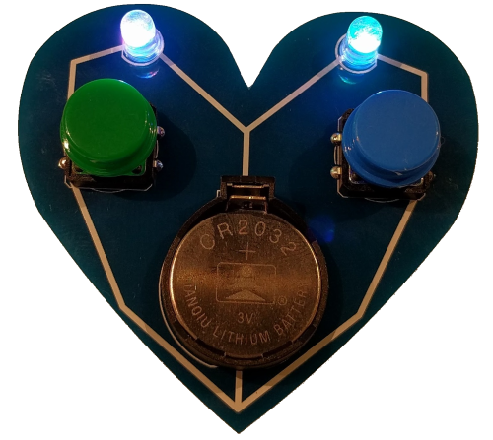
Previous Learn To Solder Kits

Slide 6
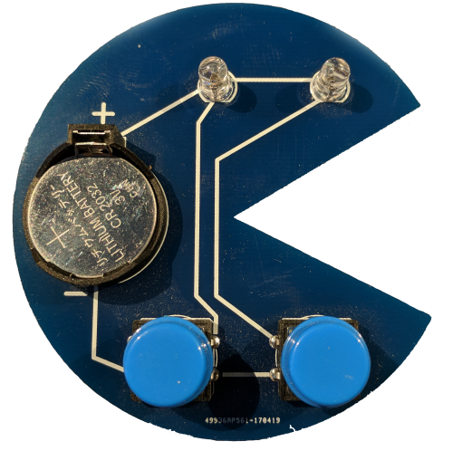
Previous Learn To Solder Kits

Slide 7
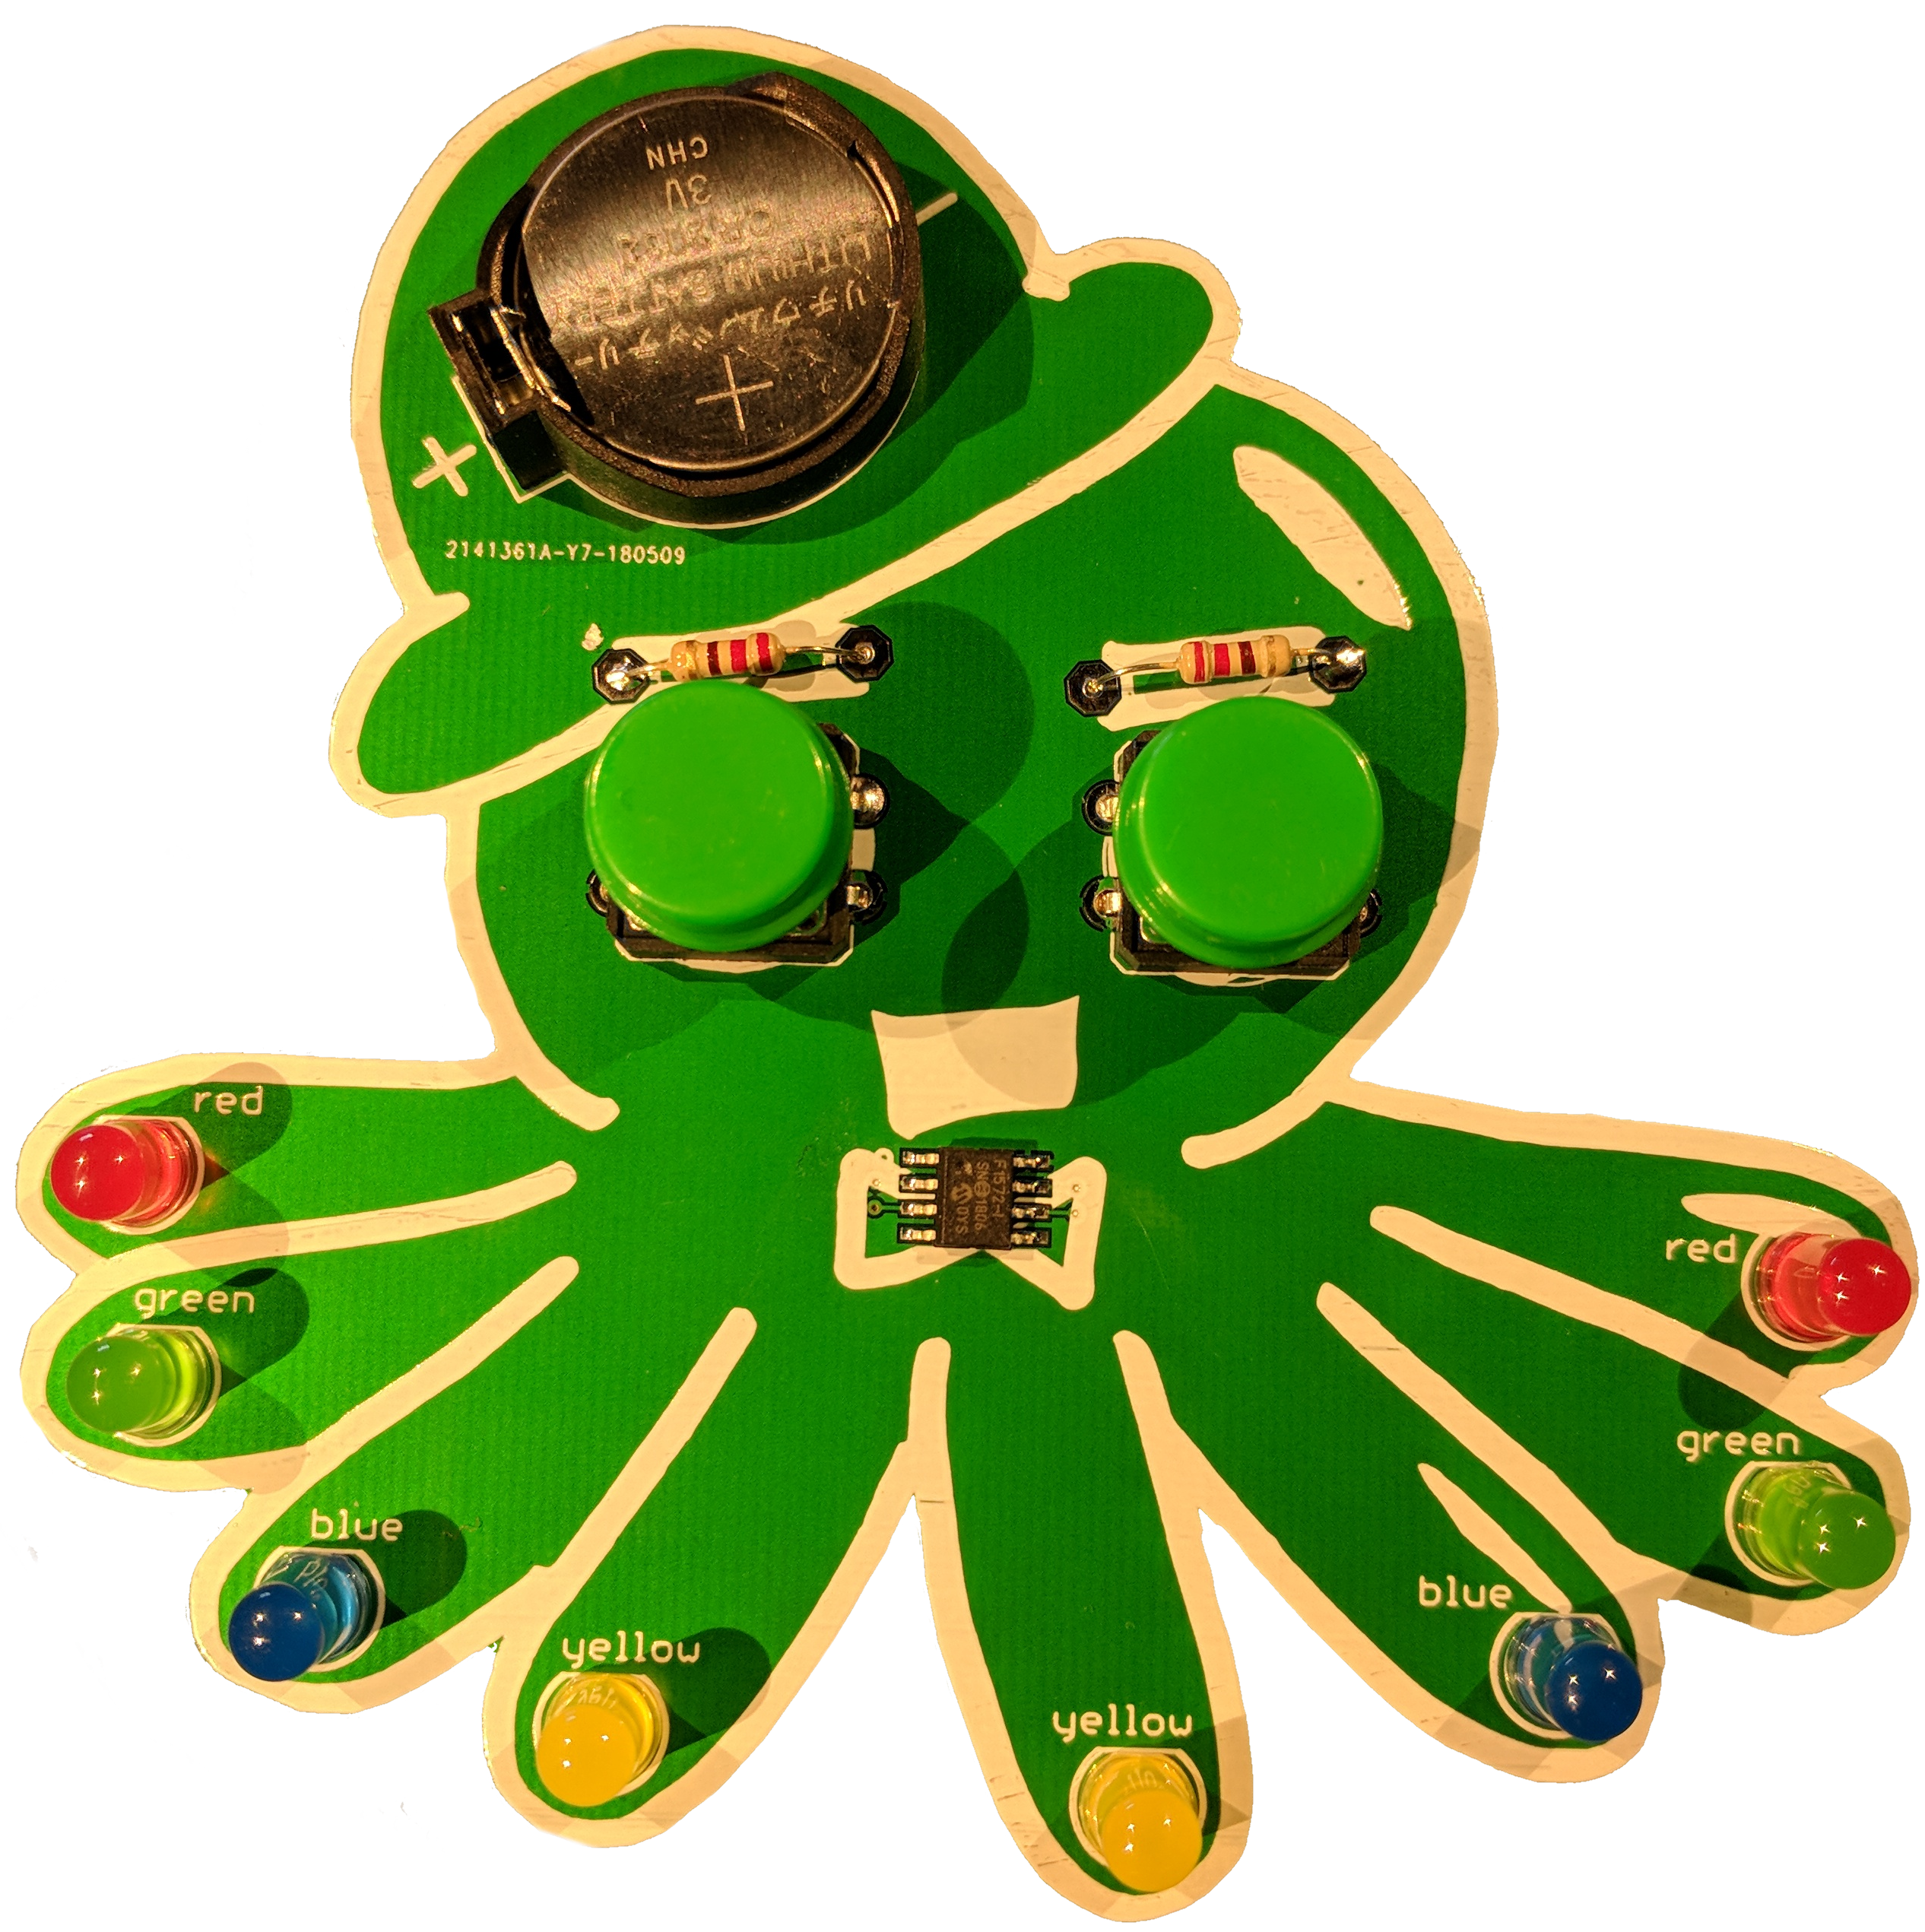
Previous Learn To Solder Kits

Slide 8
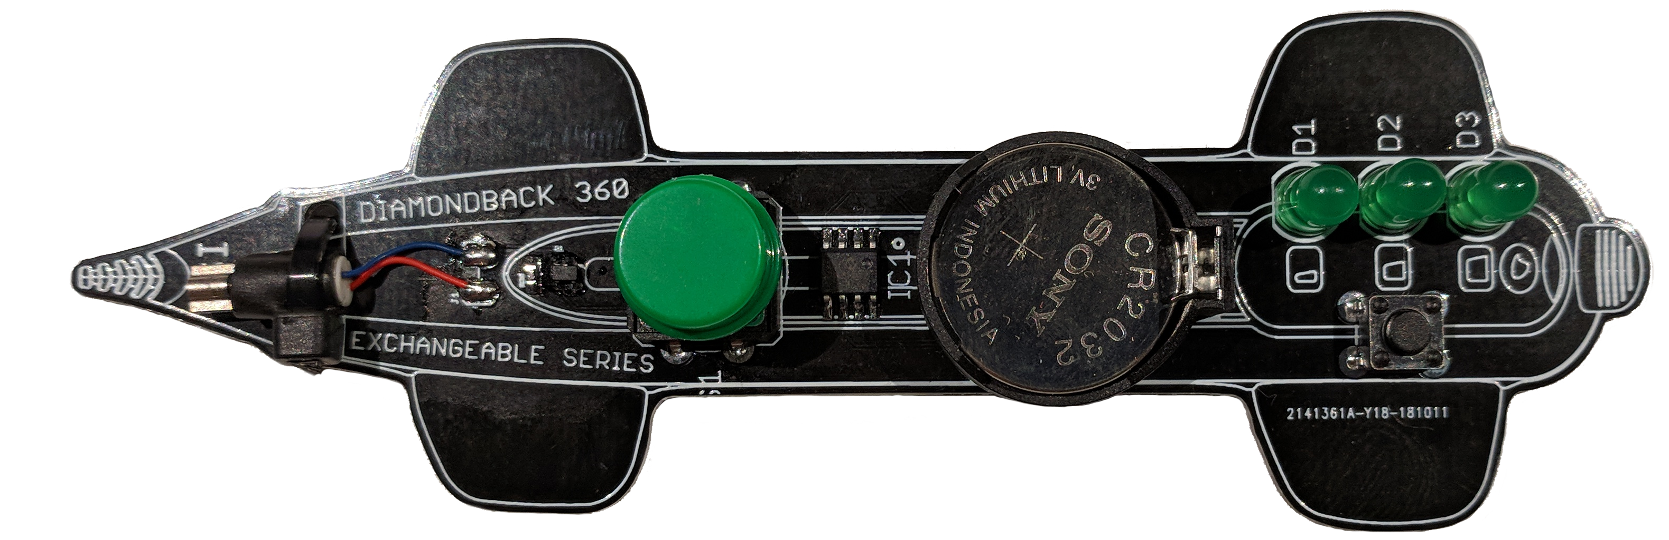
CSI Custom Designed Learn To Solder Kit: Soooo awesome

Slide 9
CSI Custom Designed Learn To Solder Kit
Speed Lights
Speed Switch
Motor
Battery
Start Button

Slide 10
High Level Kit/OAD Comparison
Diagram of kit parts
Diagram of simplified OAD parts
Both have circuit board, motor, start switch, speed switch(s), LEDs, power supply, microcontroller (processor)

Slide 11
How does it work?

Slide 12
Time to start soldering! First, some words about safety:
Put all your food away – garbage/recycle preferably.
Once you’ve touched the solder (which has lead in it) do not eat anything or lick your fingers
Biggest danger: Solder iron tip – it’s really hot!
Do not touch it
Do not let it touch anything burnable (your partner, the table, hair, etc.)
Second biggest danger: flying wires when you use the wire cutter
Wear the safety goggles at all times while soldering – no eye injuries allowed

Slide 13
Helpers will hand out all the parts you need
1 bare PCB (board)
1 battery holder
1 battery
3 Green LEDs (lights)
1 speed switch
1 start switch with green cap
1 motor
1 black zip tie
4 rubber stick on feet

Slide 14
Tools : Each soldering station has the following tools
Soldering iron (handle + base)
Soldering iron tip cleaner (brass sponge)
Roll of solder
Wire cutters (blue handles)
Needle nose pliers (red handles)
Soldering Matt (blue square)

